Slide 1


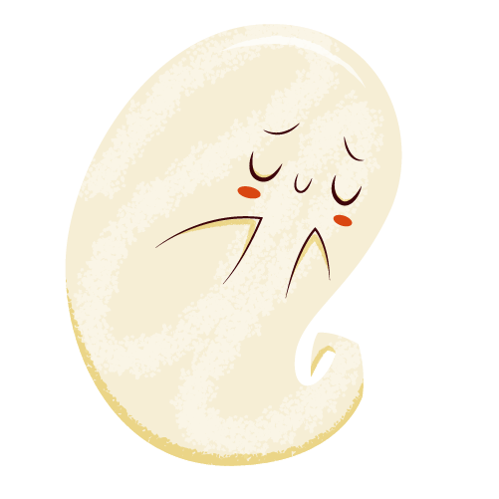
JUSTICE FOR
GHOST
Presented by Akram & Barath

Slide 2
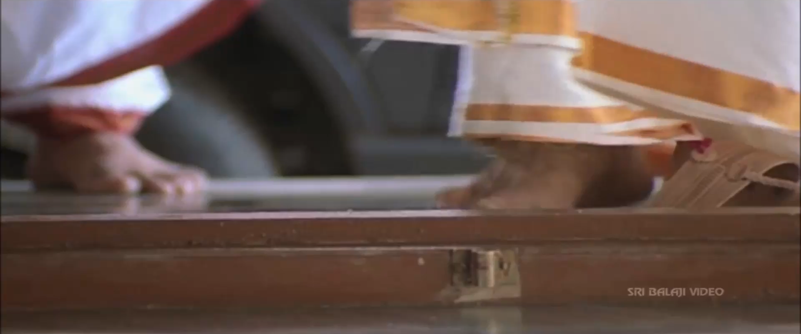
DISLIKES
The top most disliking factors for ghost is invinting a samiyar to evacuate the ghost out from your home.

Slide 3
No need of evacuation
01.
02.
03.
COEXISTENCE
NO POSSESS
FREE OF RENT
04.
05.
06.
ZERO EXPENSES
NO BAD INTENTION
HARMLESS
They just want to exist with you
They never possess anyone in your home
They don’t increase your rent
No physical loss for you
Never turns your gas on to burn your whole house
Zero harm casused by ghost

Slide 4

Ghost never disturbs you
You disturb yourself
You get scared when someone suddenly passed/showed up at your back (It’s 100% your fault)

Slide 5

SUCCESS RATE OF INVISIBILITY
Ghost only shows up merely for 3 seconds and you are getting panicked for that.

Slide 6
Ghost helps and Our misconceptions
Case study from GRO(Ghost Research Organization, 2018):
80% of ghosts at every households trying to help humans, But they are holding themselves from doing that to not piss you off.

Slide 7

Ghost’s good intensions == fear?
Turning off the light
Closing the door
Free massages
And more

Slide 8
HUMANS ARE PREJUDICE
Human judges ghost within seconds, just because they’re not alive.
Is this the real qualification to be good or bad?
Murderer, psychopaths, criminals also alive but they do way crucial things than ghosts.
Is ghost really unsafe?

Slide 9
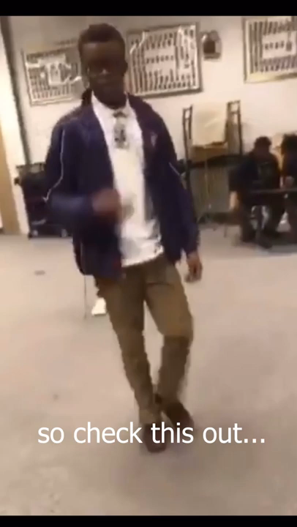
When to really call the Samiyar?
Never, fight it yourself.

Slide 10
UNPOPULAR OPINION: GHOST MOVIES AREN’T SCARY AT ALL…

Slide 11
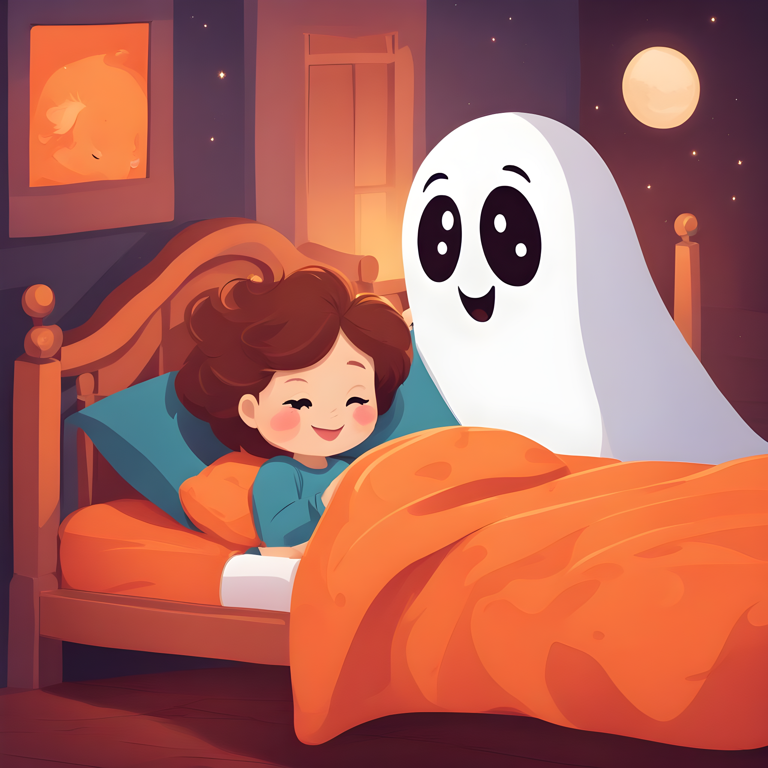
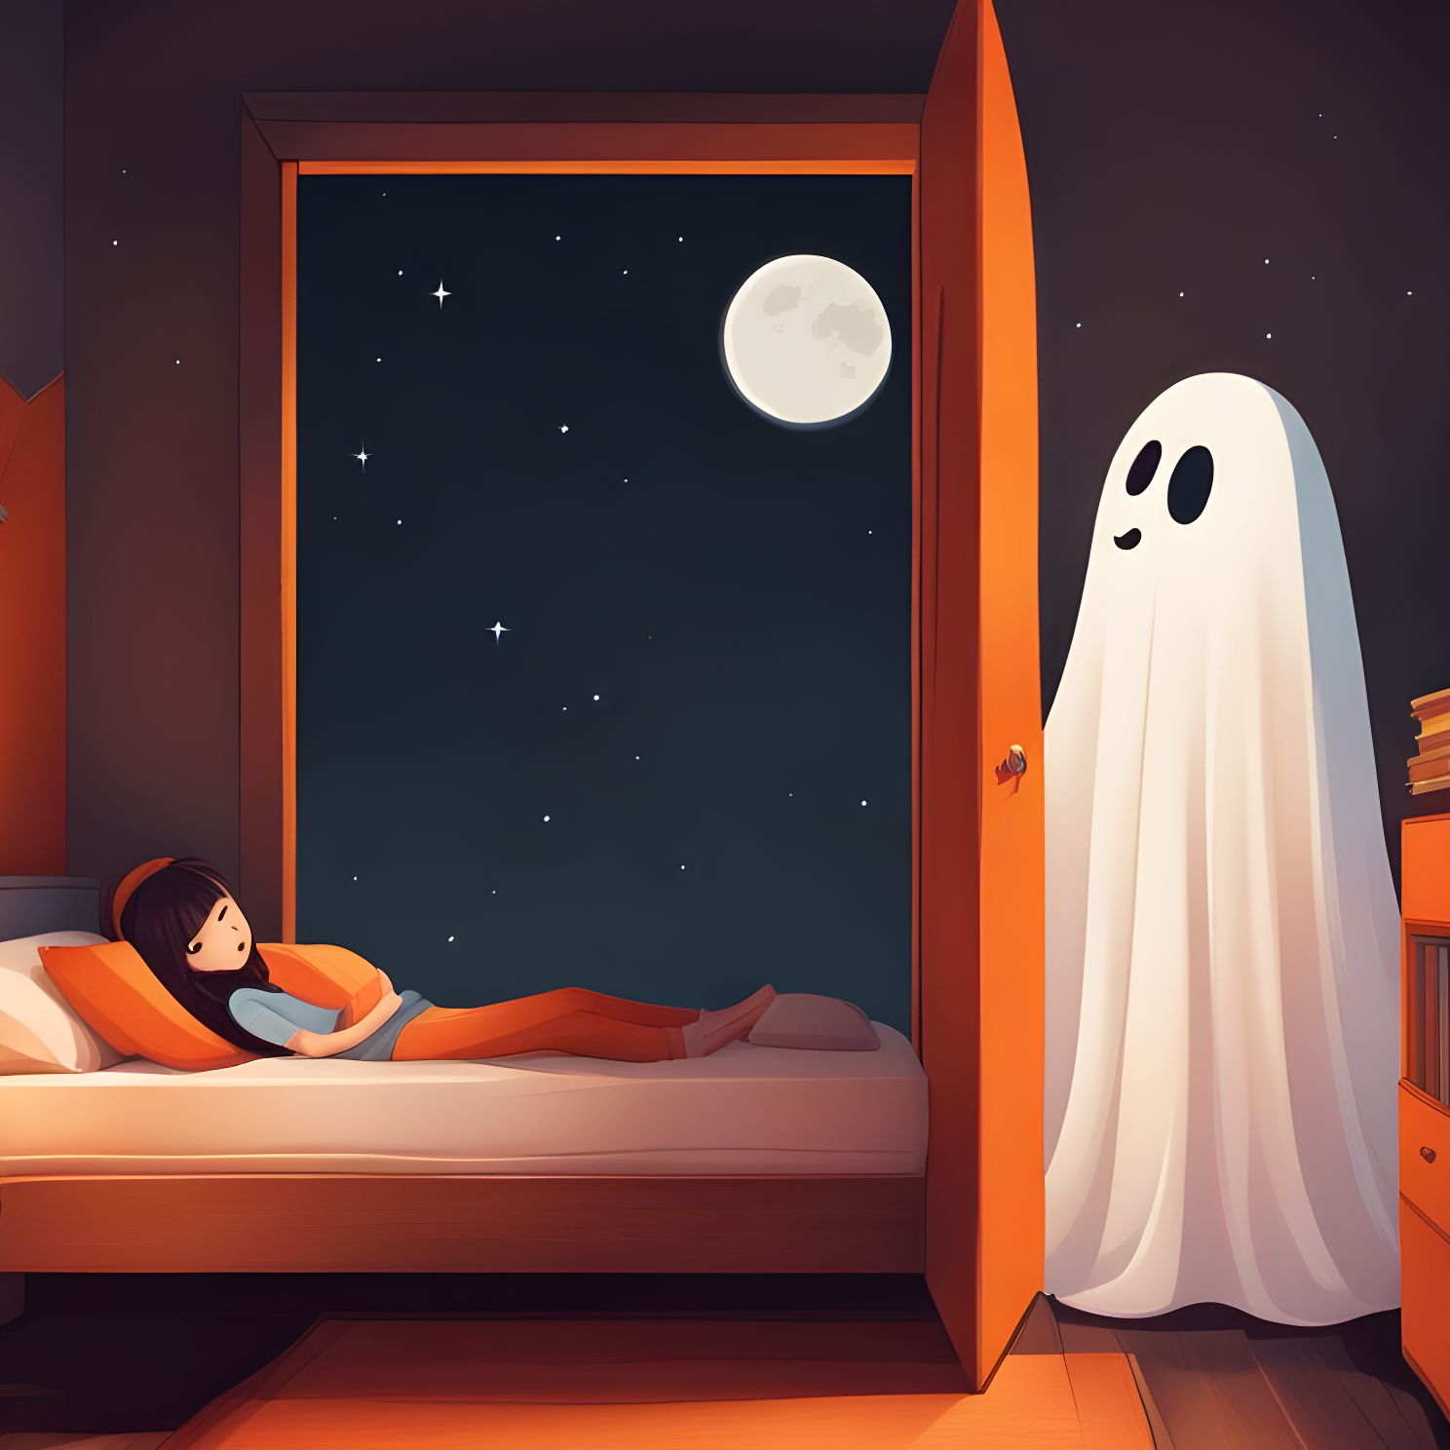
UNDER THE BED MONSTERS.
Reasons, Dumb Logics and Actual Intensions

Slide 12
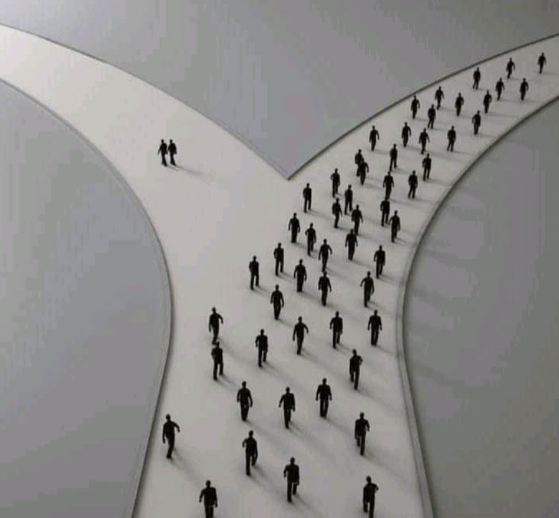
Final Verdict
People Who Supports Ghost *
* People Who Oppose Ghost

